Slide 1
Business Overview
Discover the beauty
in every recycled piece, where sustainability meets innovation.

Slide 2
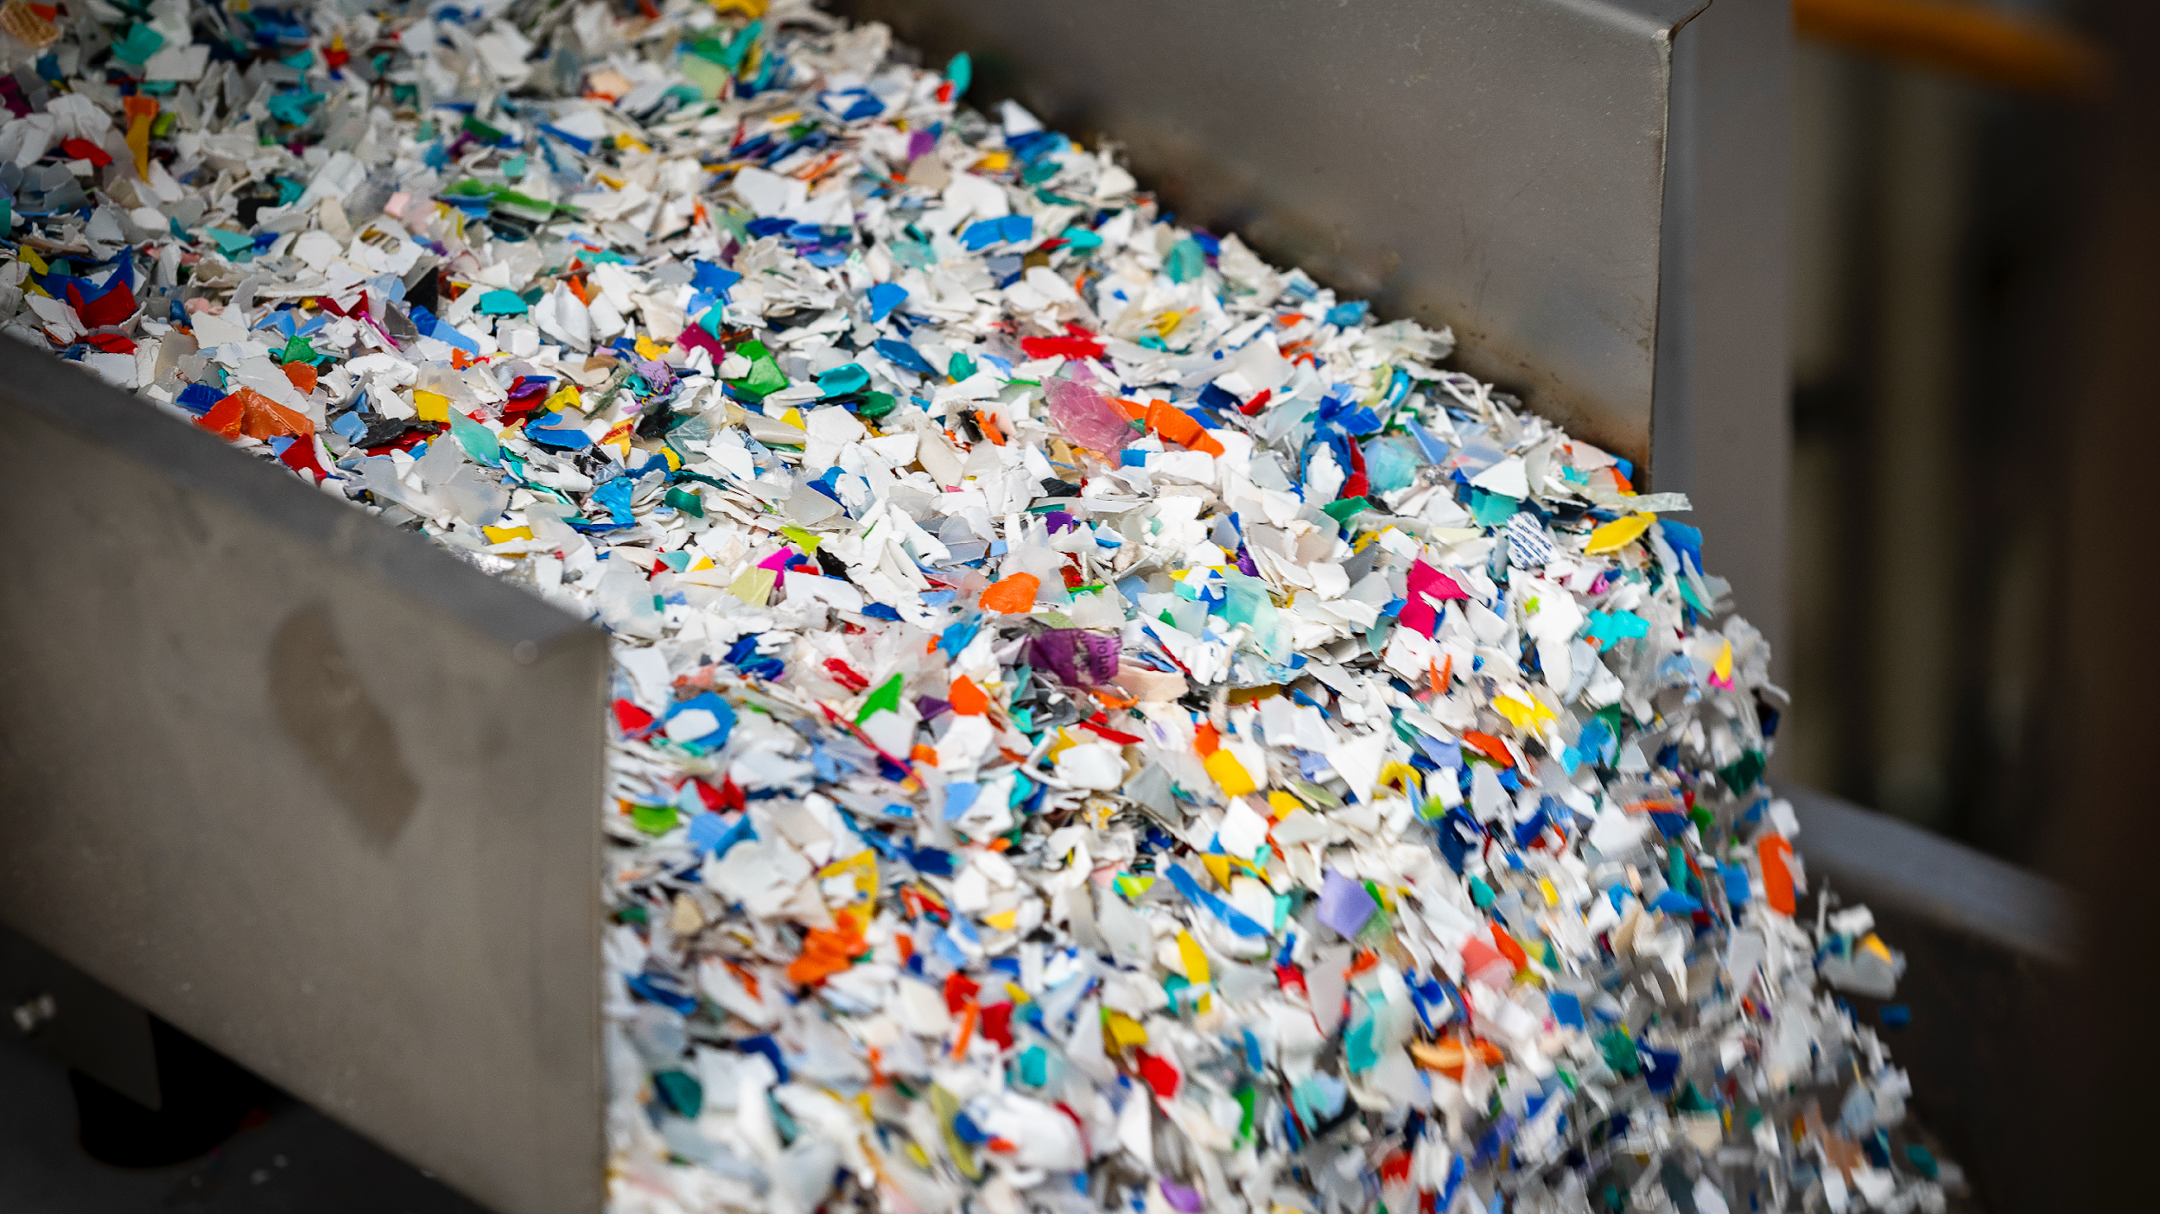
ABOUT US

Slide 3
Industrial holding and services provider
Rigid plastic packaging manufacturing
Engineering centre for
machines and plant technology
Pilot and industrial
mould manufacturing
OLD MILL HOLDING
Plastic packaging for pharmaceutical sector
Packaging design, development, innovation and sustainability
Recycling solutions and services for sustainability projects
Recycling facility

Slide 4
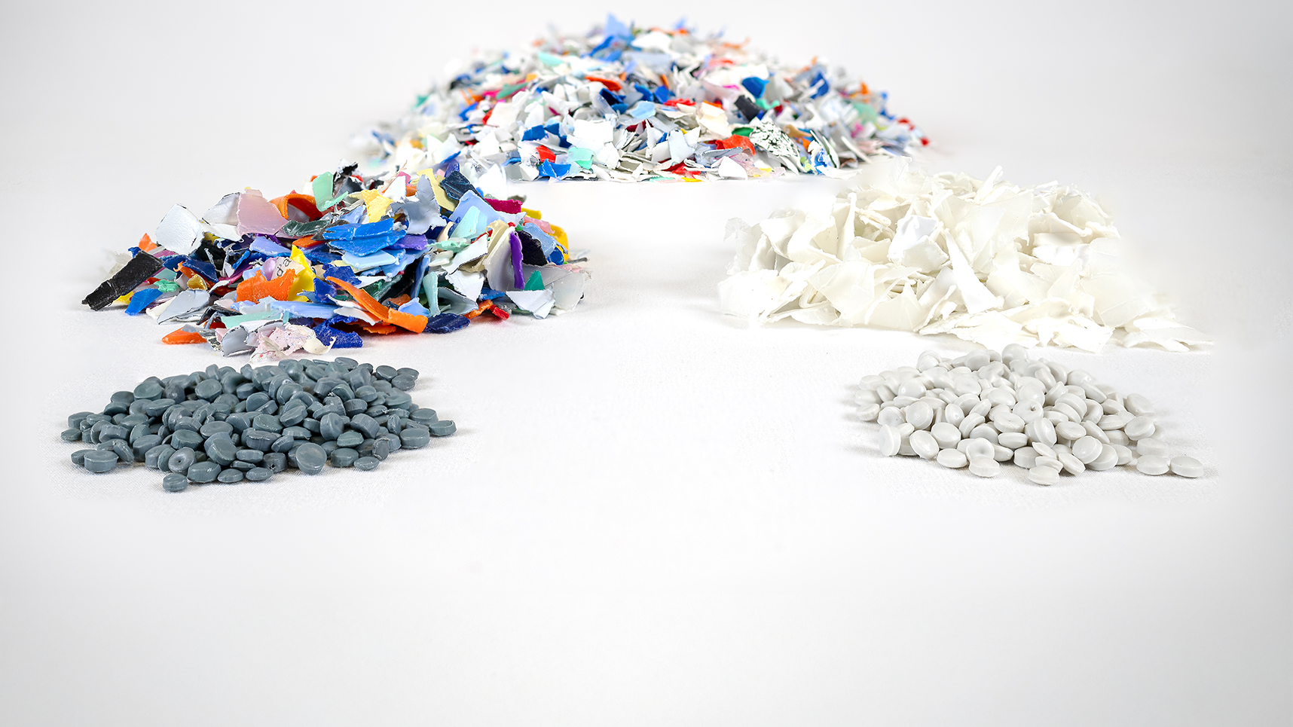
Founded in 1991, Centro Plastica is a mechanical recycling company specialised in producing rHDPE pellets from post-consumer waste.
Acquired by the Serioplast Group in 2018, it operates two production facilities with a total area of 8,800 m², processing up to 20,000 tons of plastic waste annually.

Slide 5
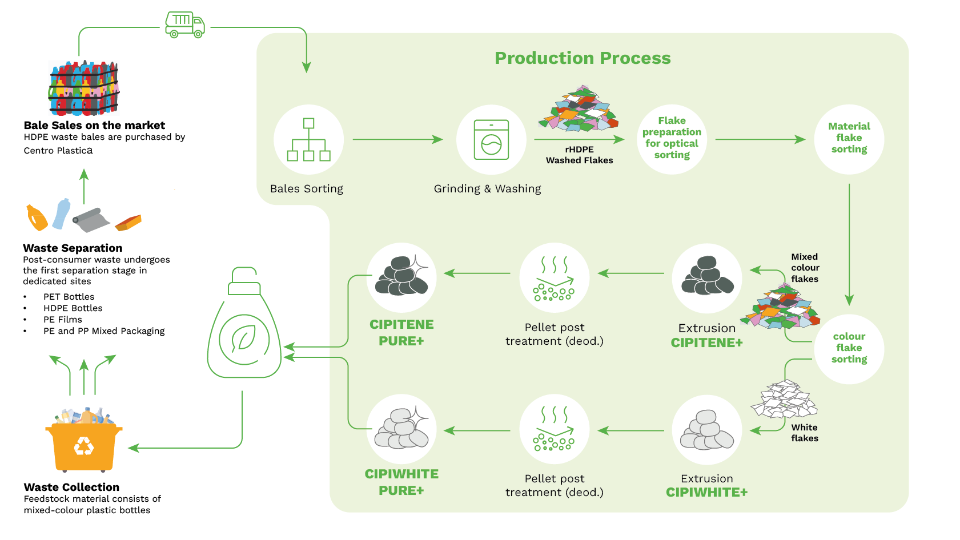

Slide 6
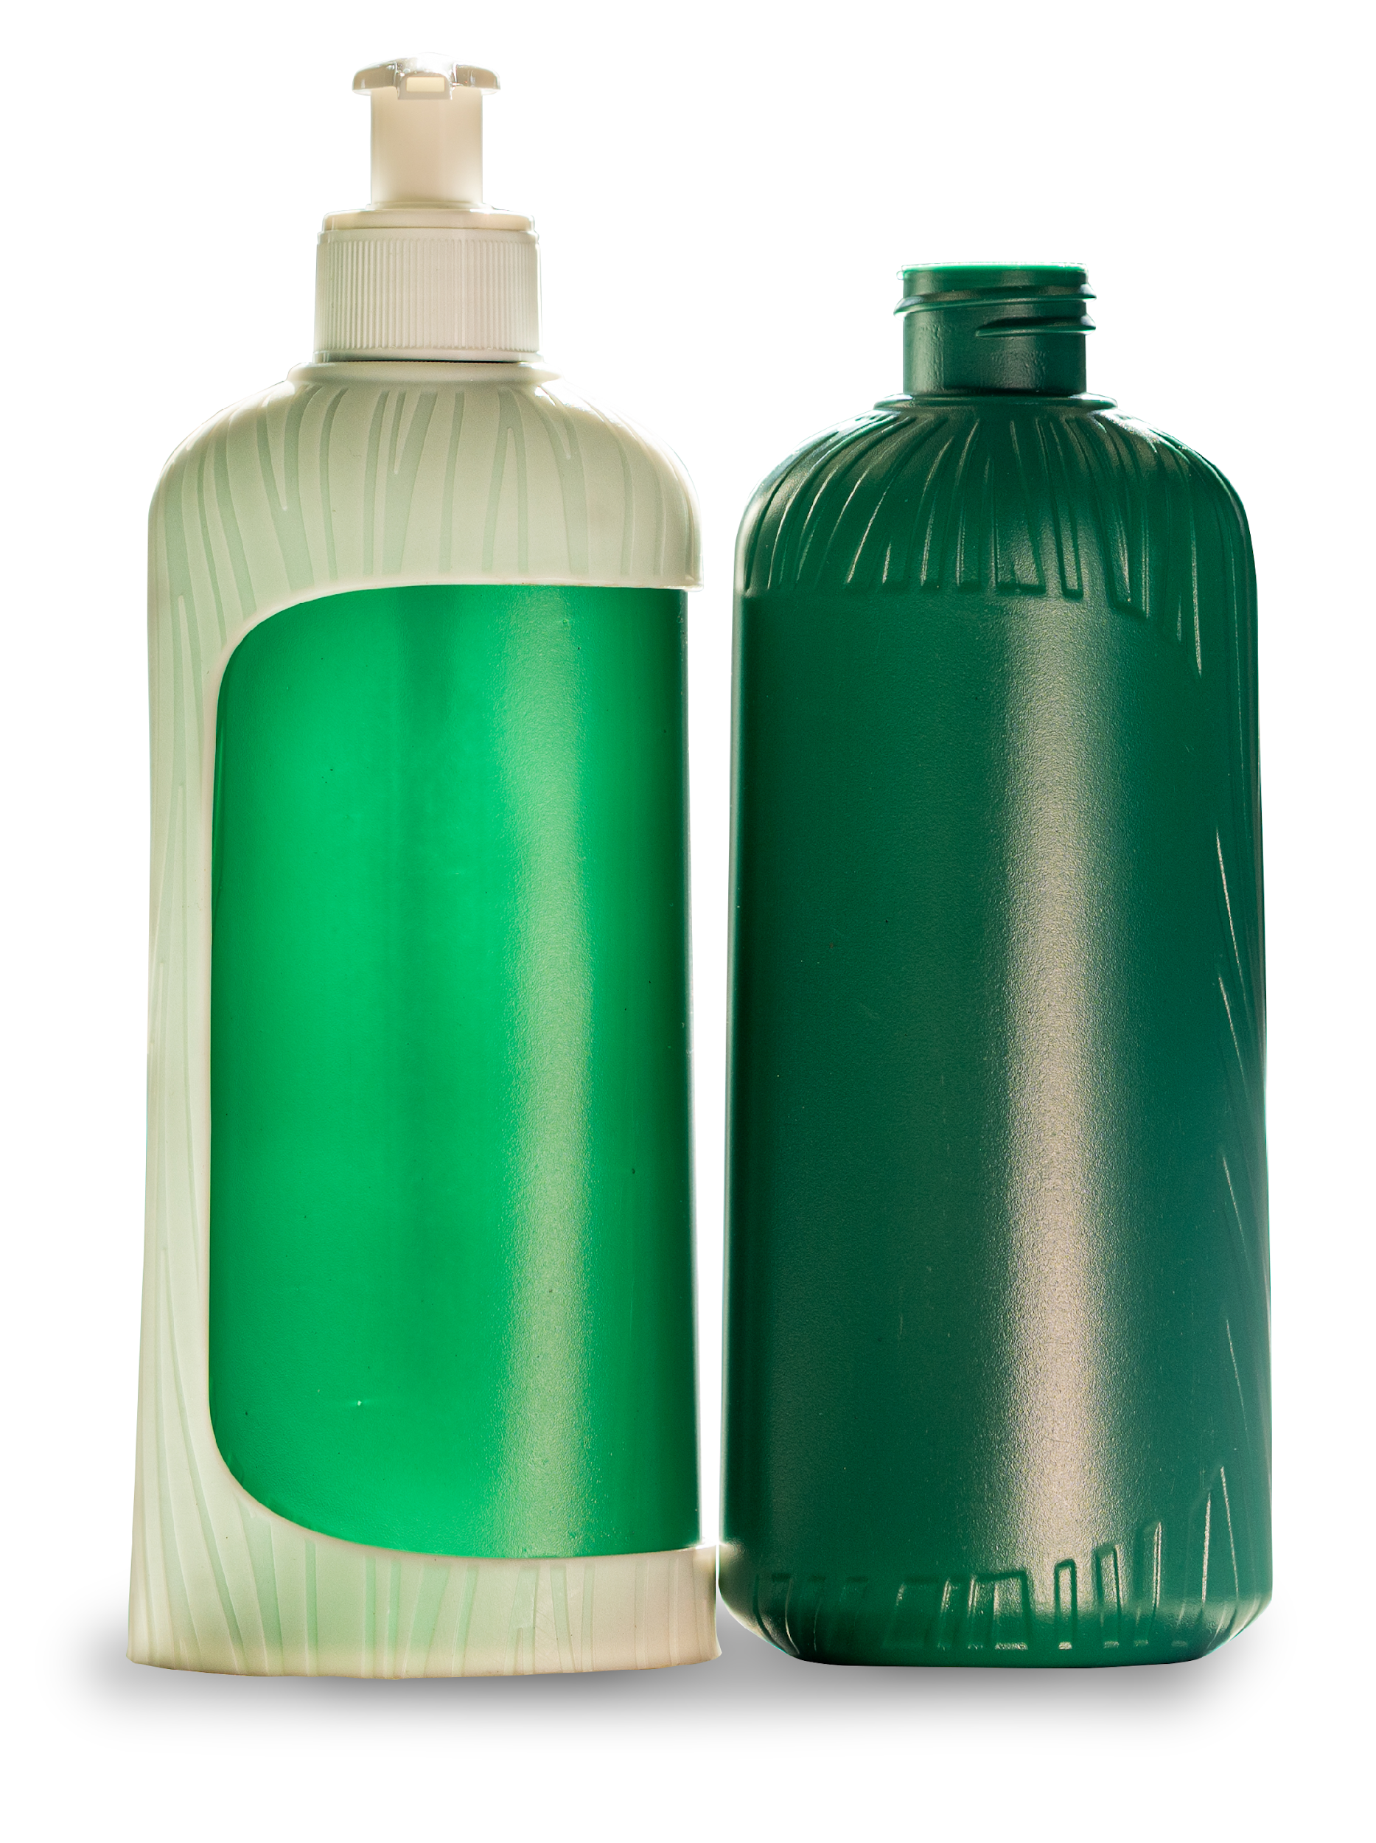



Markets and Production
APPLICATIONS
Home care & Laundry, Personal care
MARKETS
Italy & Europe
RECYCLING METHOD
Mechanical recycling
MAIN SOURCE
Rigid packaging
PRODUCTS
Recycled Post Consumer High Density Polyethylene (rHDPE)
TECHNOLOGICAL SUSTAINABILITY
Extrusion and extrusion blow moulding (EBM)

Slide 7
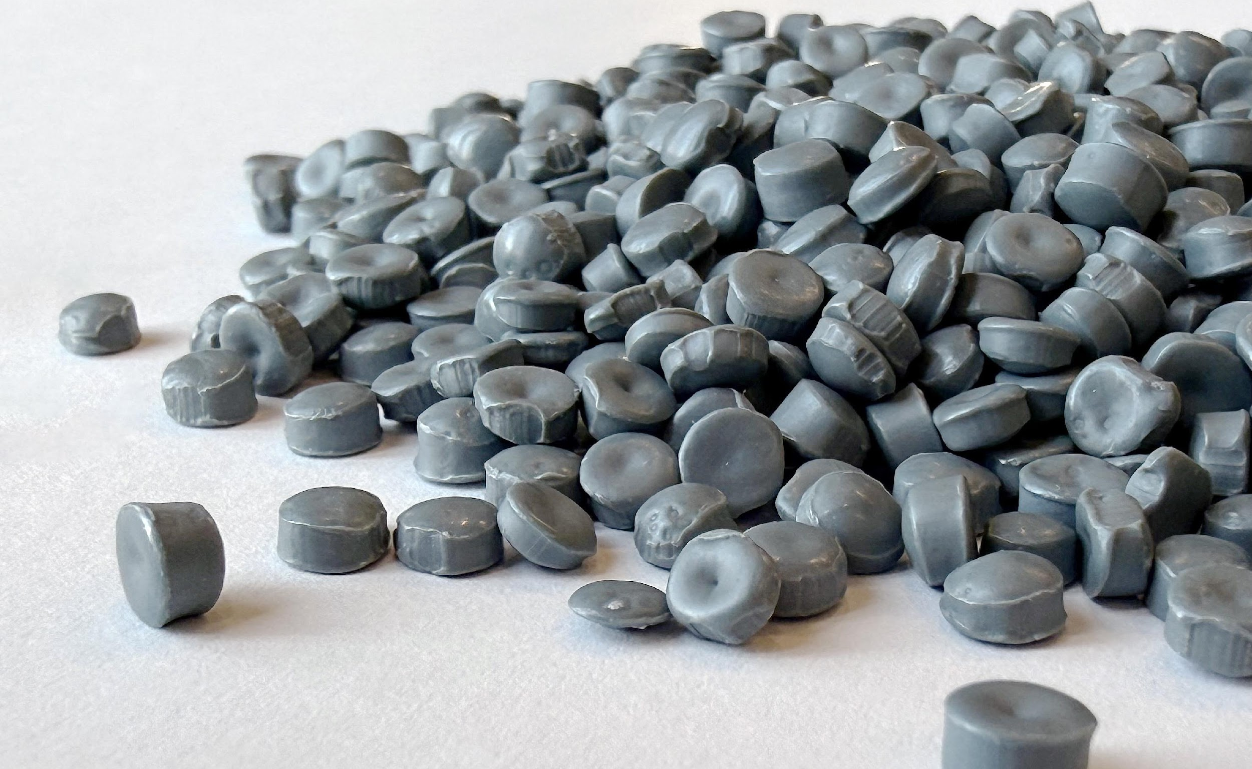


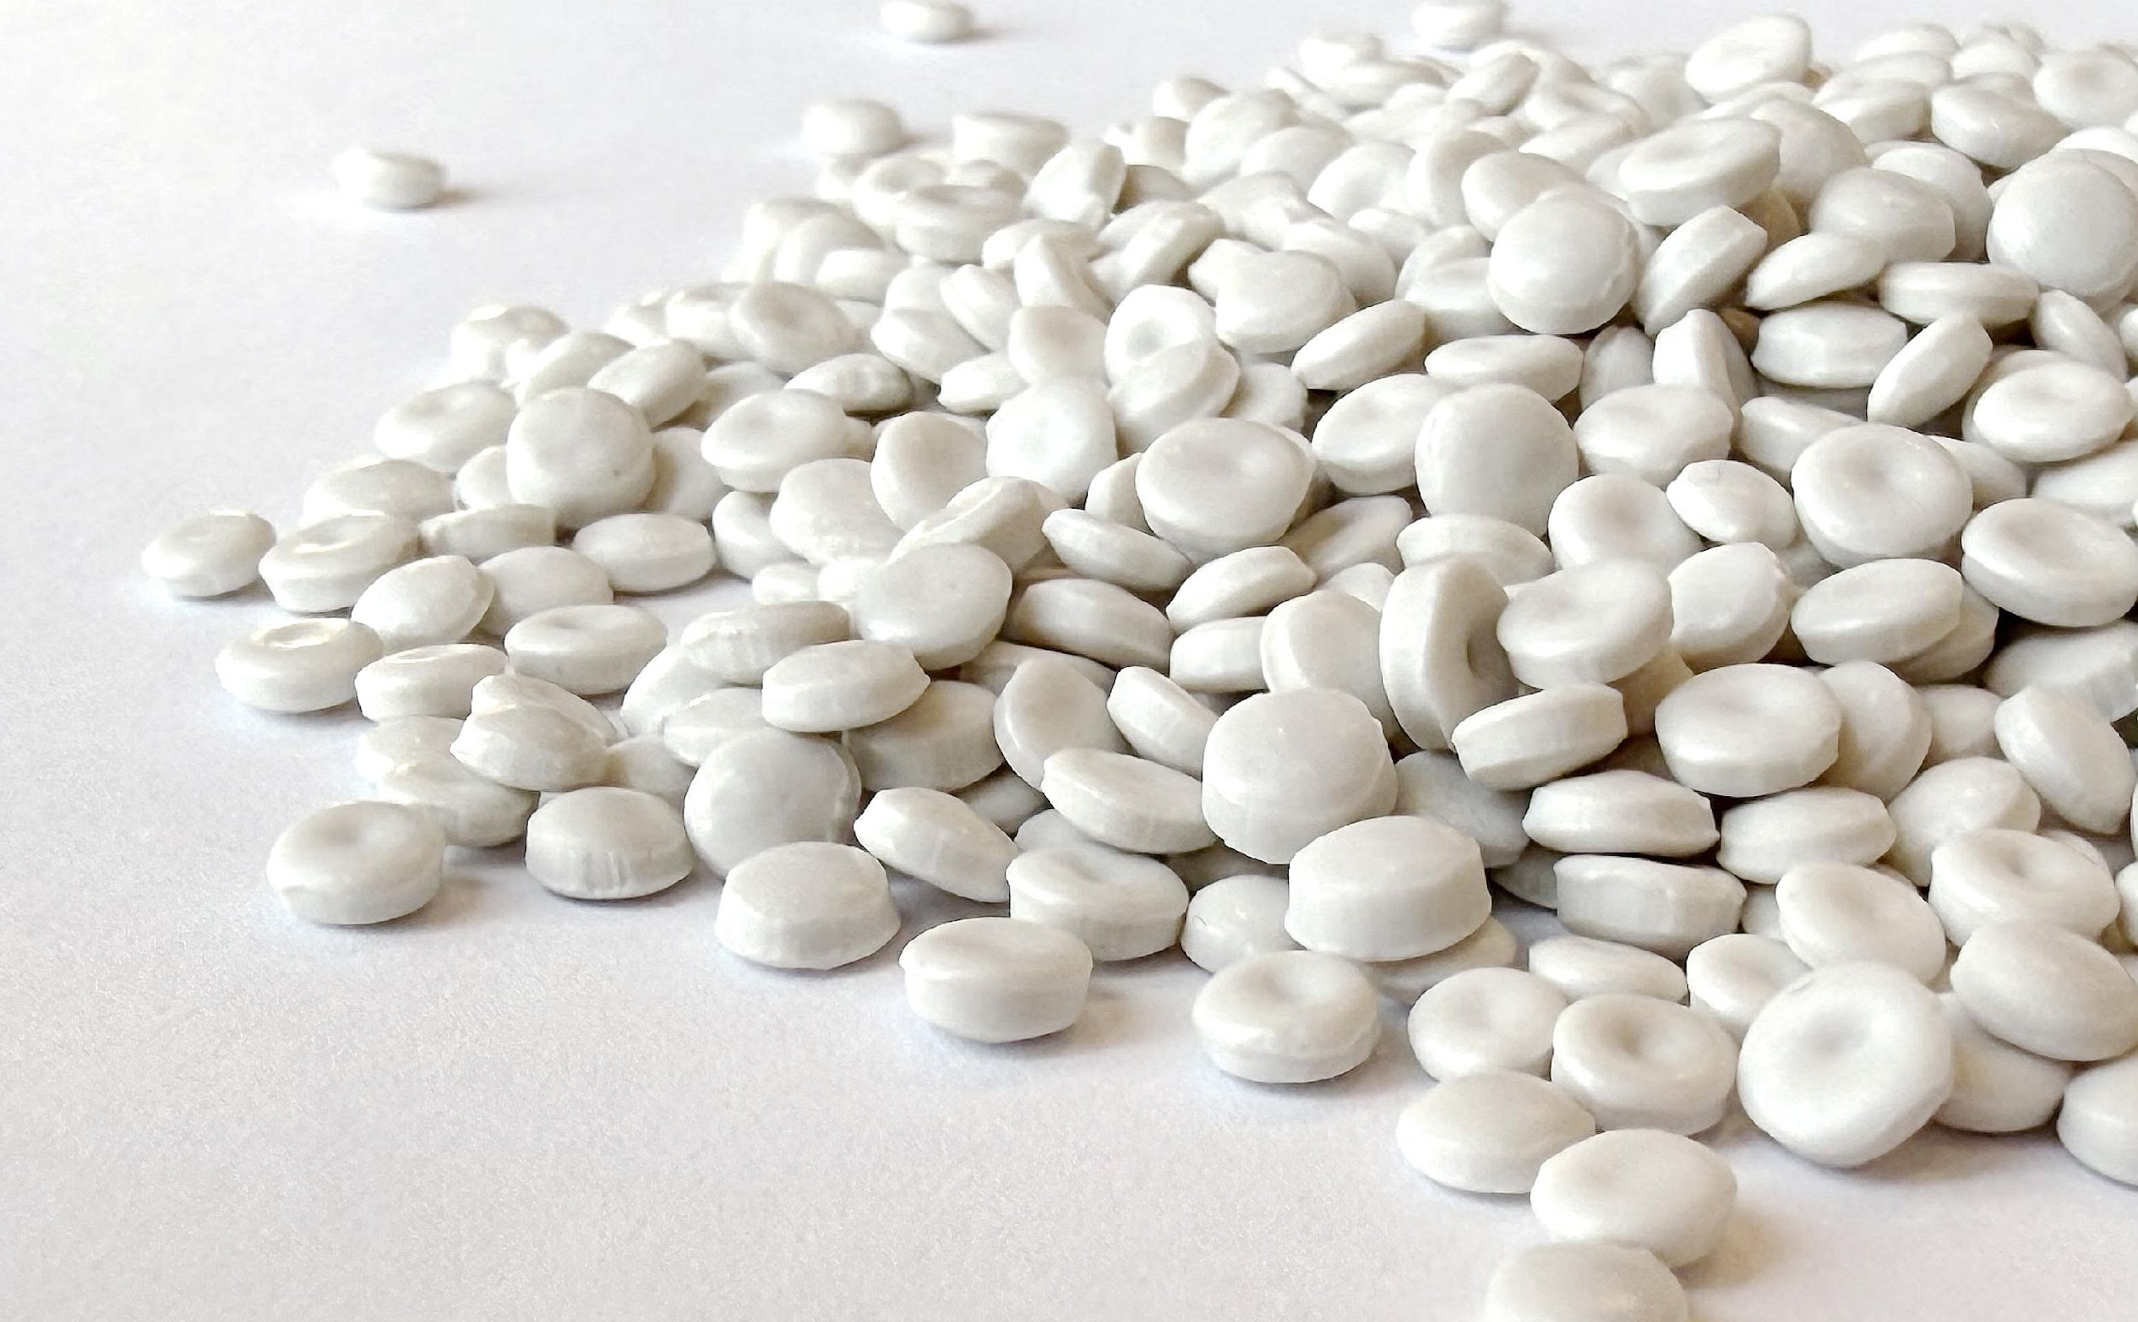
Products
We produce high-quality rHDPE pellets from post consumer waste, suitable for extrusion and extrusion blow moulding
Grade | Colour | Deodorisation | Material selection
CiPiWHITE+ | White
CiPiWHITE Pure+ | White
CiPiTENE+ | Grey
CiPiTENE Pure+ | Grey

Slide 8

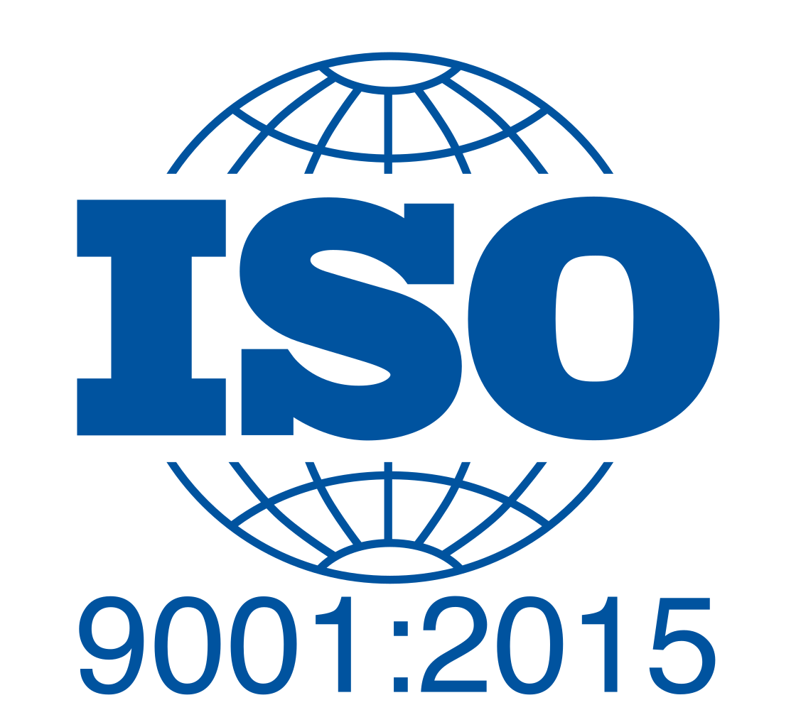


Certifications
Quality
management
systems
Environmental management
systems
European Recyclability
assessment for plastic packaging

Slide 9




Sectors of application
Our materials can be used in various sectors, such as home care and personal care packaging, gardening, road signs, piping
HOME CARE
PERSONAL CARE
GARDENING
ROAD SIGNS
PIPING

Slide 10

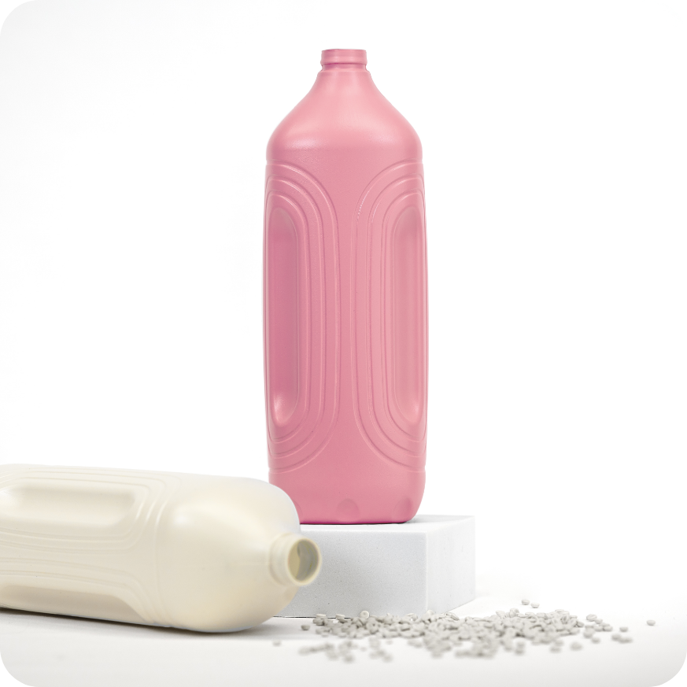
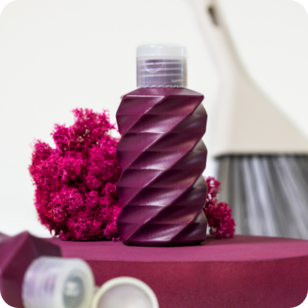
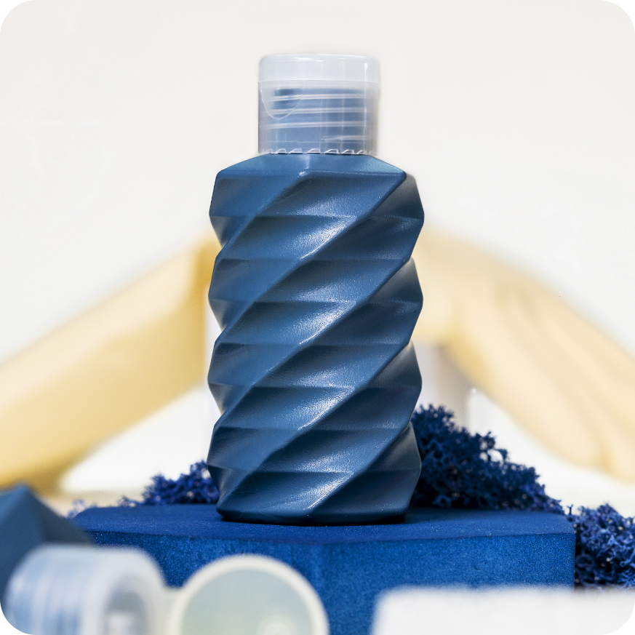
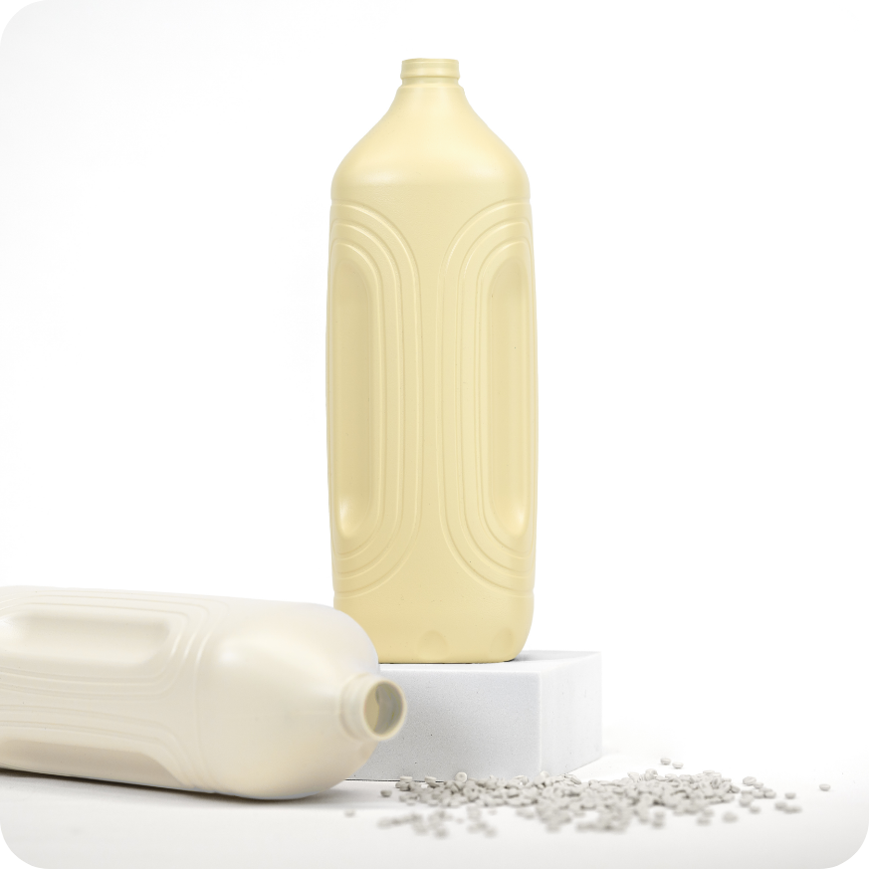
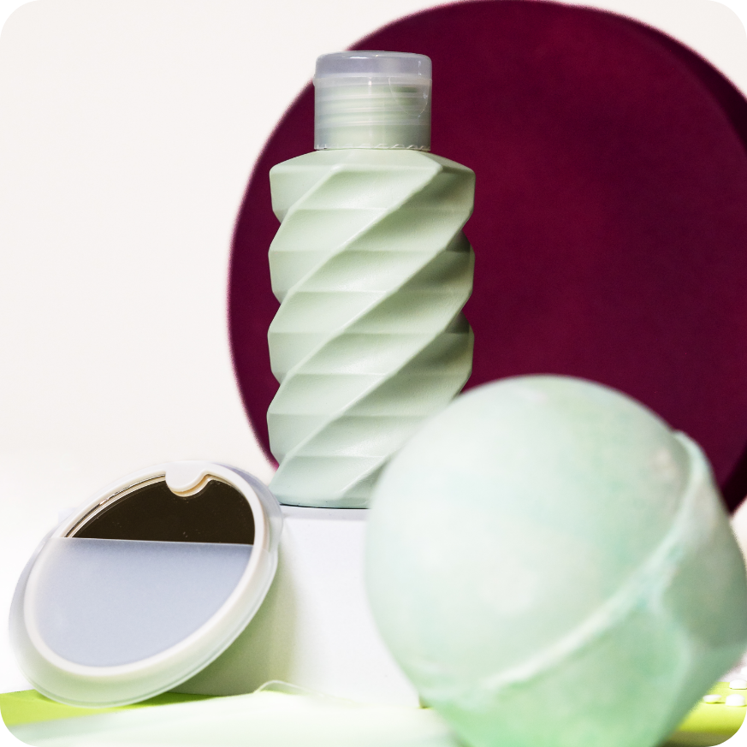
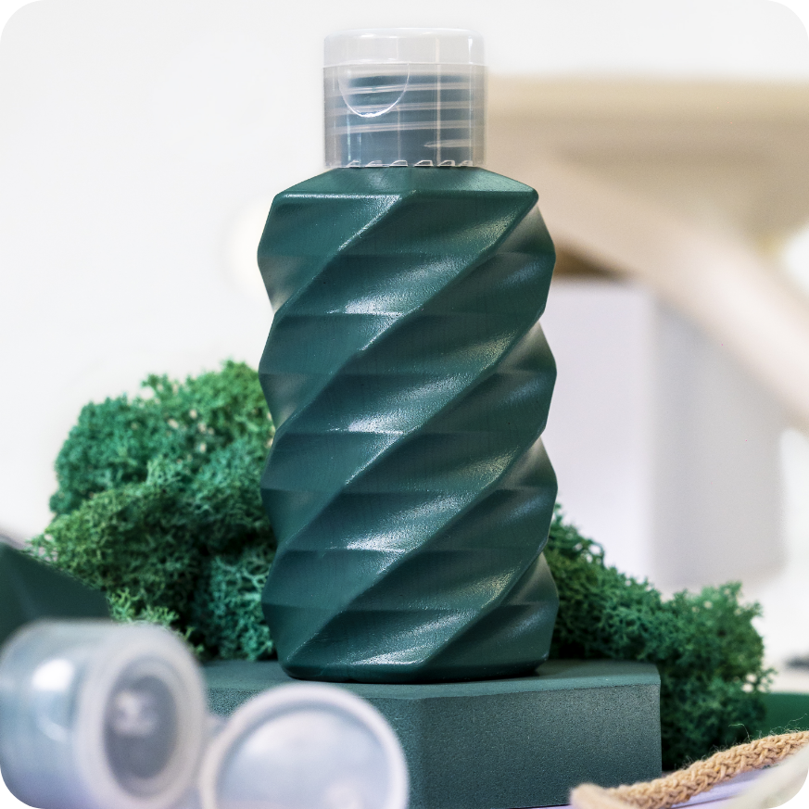
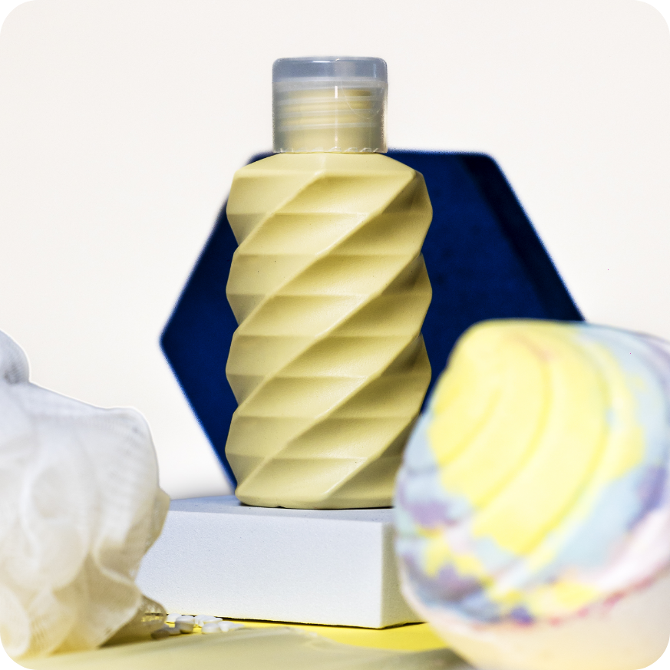

A story of innovation and success
The Prejudice
The reality
Recycled plastic is often perceived as a second-choice material: dull colours, lower quality, limited versatility.
Thanks to our technology,
we can achieve beautiful
and functional materials.

Slide 11
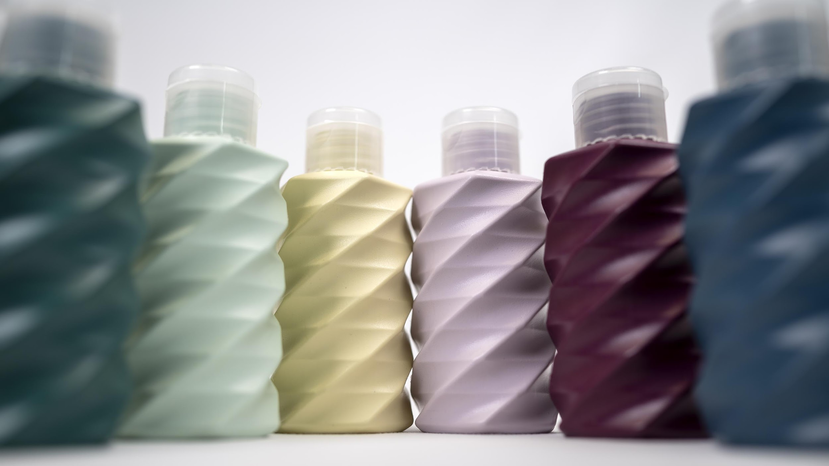
TOGETHER WITH OUR SUPPLIERS,
we developed high impact colours
for white and grey pellets.

Slide 12
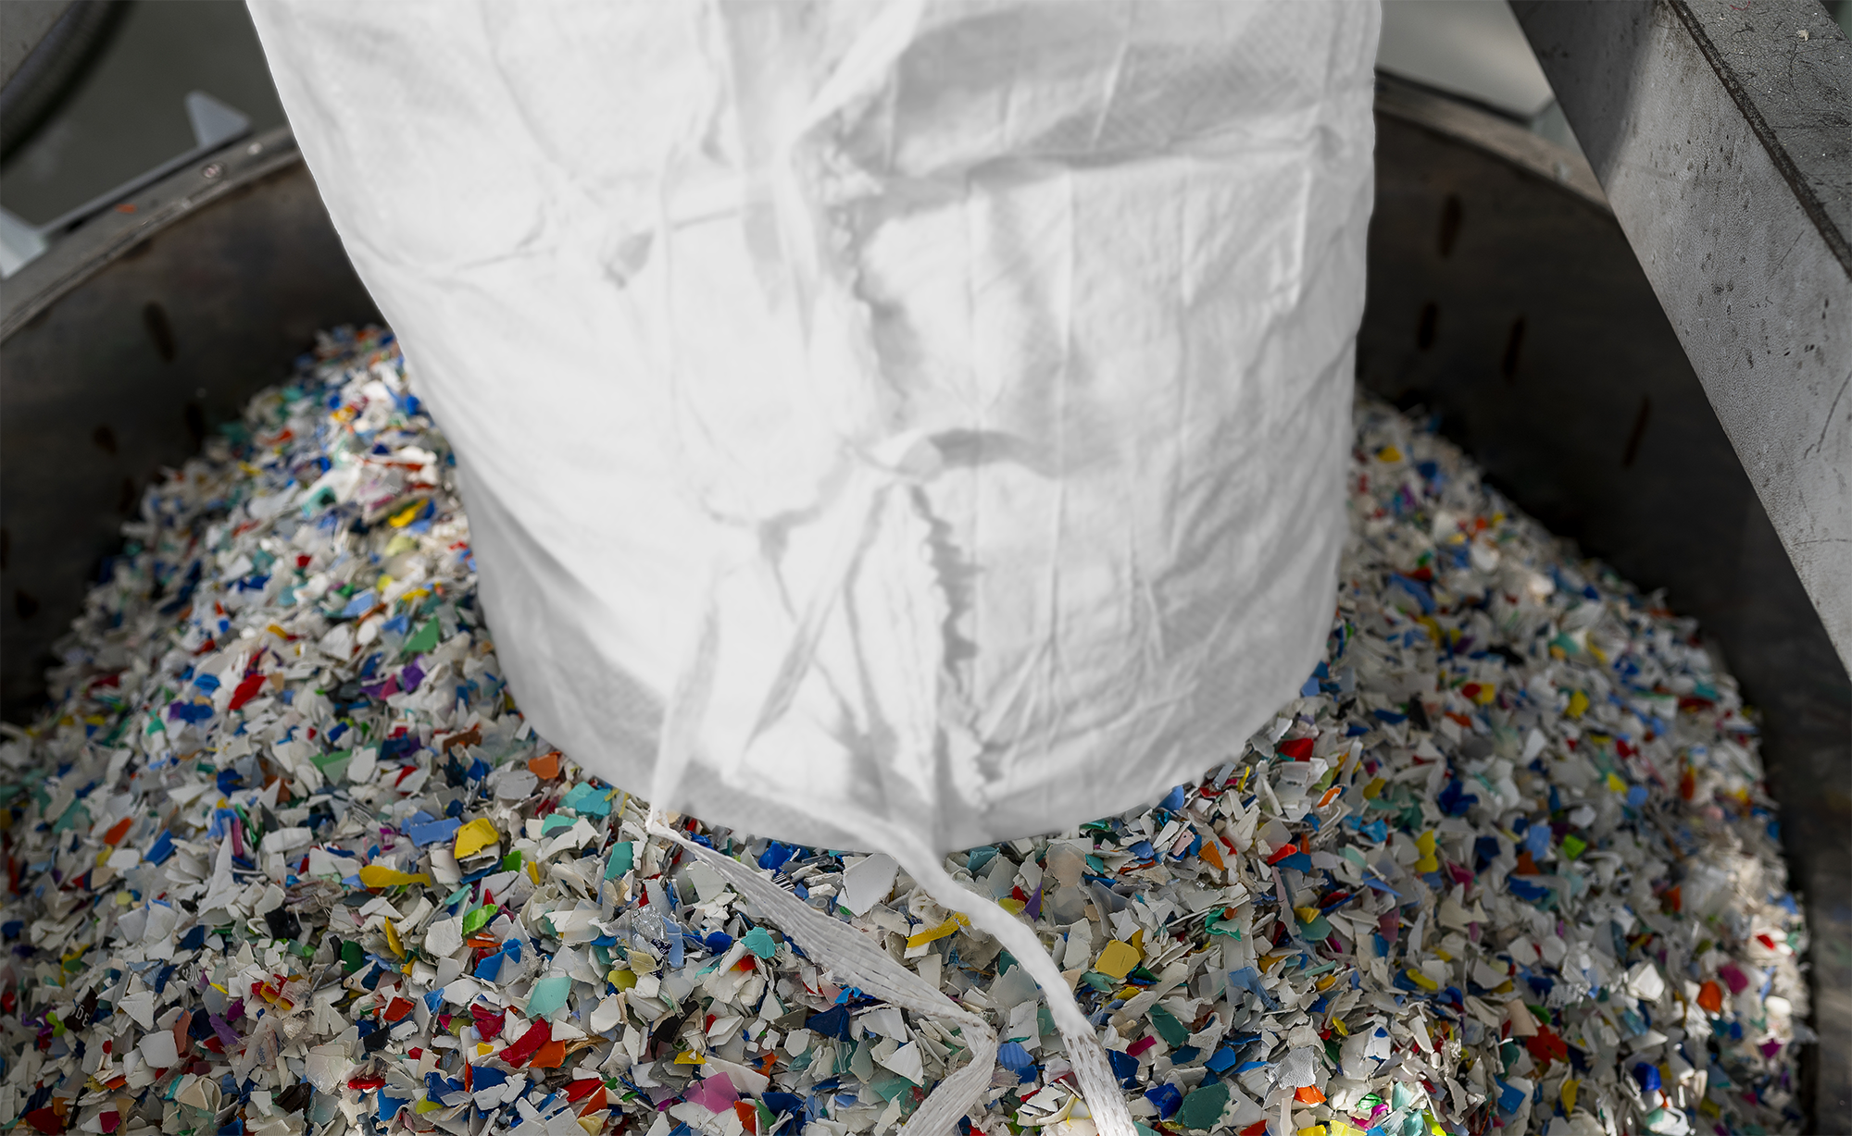
Compounds development
Thanks to the collaboration with Serioplast R&D and external laboratories we are developing compounds tailored for different technologies, like blow moulding and injection moulding.
Compounds development
Thanks to the collaboration with Serioplast R&D and external laboratories we are developing compounds tailored for different technologies, like blow moulding and injection moulding.

Slide 13
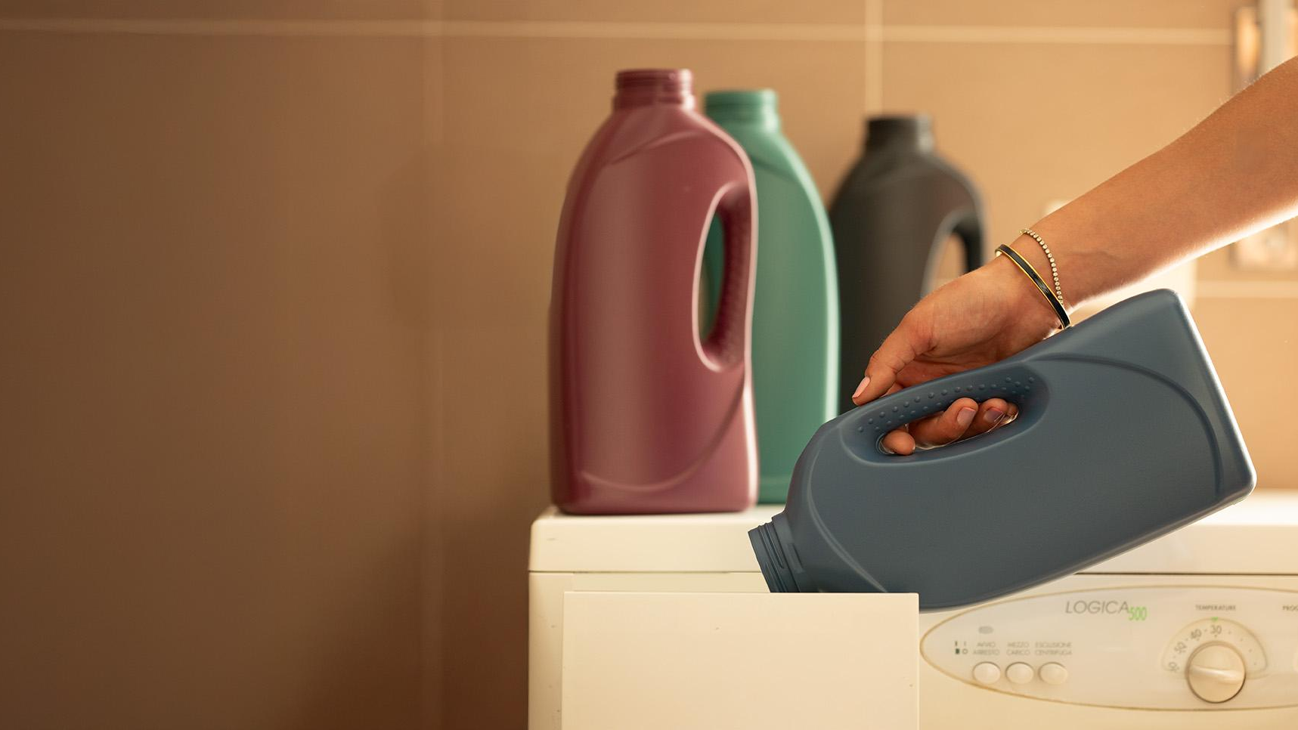
Many brands believe in our projects.
Join us in shaping
a sustainable future!

Slide 14
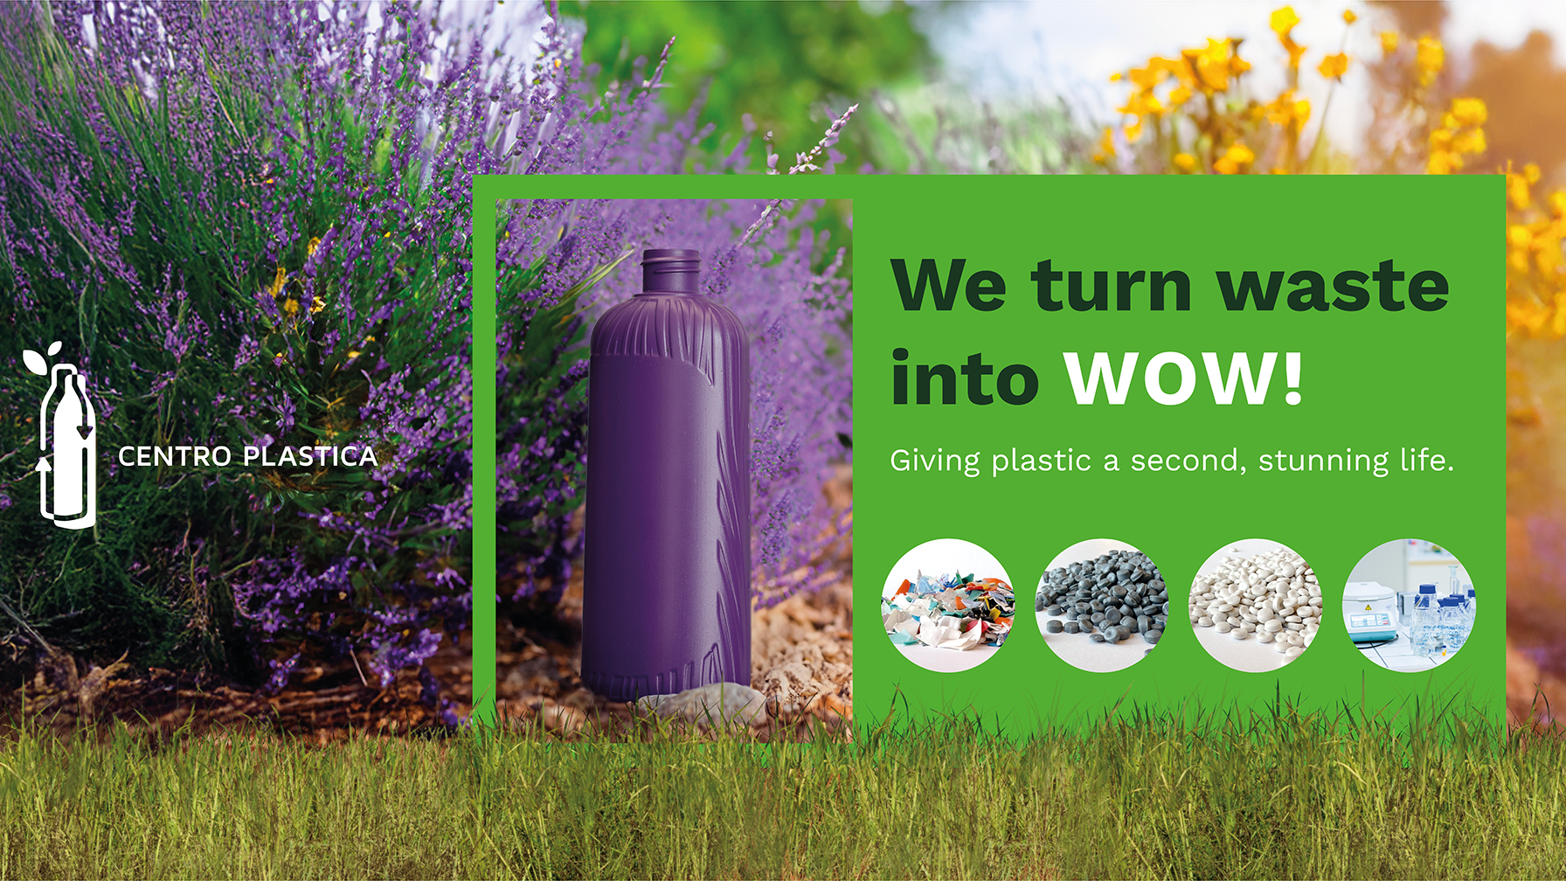

Slide 15
Thank you!
serioloop.serioplast.com

